Slide 1
RFID BASED ATTENDANCE SYSTEM
1- Nada Mohamed 18338
2-Tasneem Ibrahim 18031
3- Nesma Adel 18209
4- Mohsen Haggag 18202
5- Khaled Diab 18116
DR / KHALED SAADA

Slide 2

WHAT IS RFID ?
Radio-frequency identification (RFID) uses electromagnetic fields to automatically identify and track tags attached to objects. An RFID system consists of a tiny radio transponder, a radio receiver and transmitter. When triggered by an electromagnetic interrogation pulse from a nearby RFID reader device, the tag transmits digital data(HEX. numbers) , usually an identifying inventory number, back to the reader.

Slide 3

Types of RFID :
They are two types of RFID tags :
1- Passive tags (our tag) are powered by energy from the RFID reader's interrogating radio waves.
2- Active tags are powered by a battery and thus can be read at a greater range from the RFID reader, up to hundreds of meters.

Slide 4
Main idea of our project :
We make an attendance system , it is operating by :
When we cross the the card in front of the RC 522 , the reader reads the number of card :
If it is a valid card the door will be opened by motor and the led will toggle and the buzzer will out a sound and lcd will show “valid card” and who entered.
If it isn’t a valid card , nothing will happen and and lcd will show “invalid card”.

Slide 5
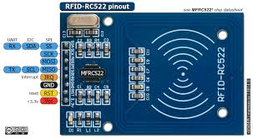
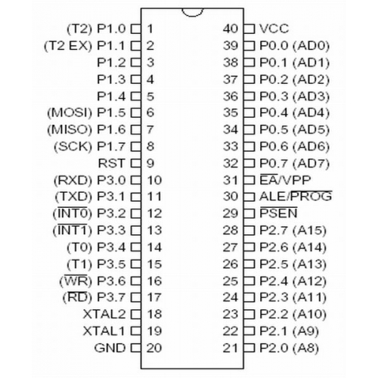
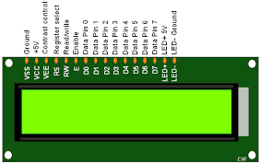
COMPONENTS OF PROJECT :
1- MicroController ( AT89S52 ).
2- RFID (RC 522).
Passive Tag.
Low Frequency.
1 cm : 10 cm.
3- LCD (LM 016).
16*2.

Slide 6
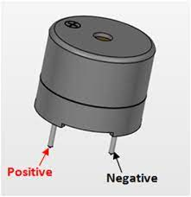
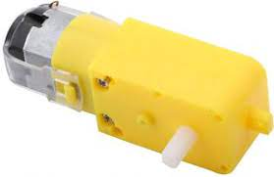
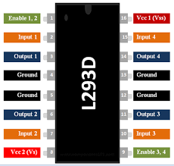
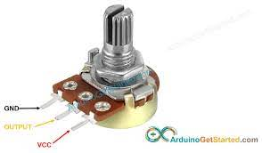
COMPONENTS OF PROJECT :
4- Buzzer.
5- Motor.
6- Driver (L293D).
7- Potentiometer.

Slide 7
FUNCTIONS OF EACH COMPONENT :
1- MicroController ( AT89S52 ) : it controls every action happens.
2- RFID (RC 522) : it is the reader which read the card which is crossing.
3- LCD : it uses to display :
The card is valid or not.
if it is a valid, lcd show which card crossed.
4- Buzzer : it uses as a detector when a card crossing it out a sound.
5- Motor : it controls the door.
6- Driver (L293D) : it is a typical Motor Driver IC which allows the DC motor to drive on the directions.
7- Potentiometer : it controls the contrast of lcd’s back light.

Slide 8
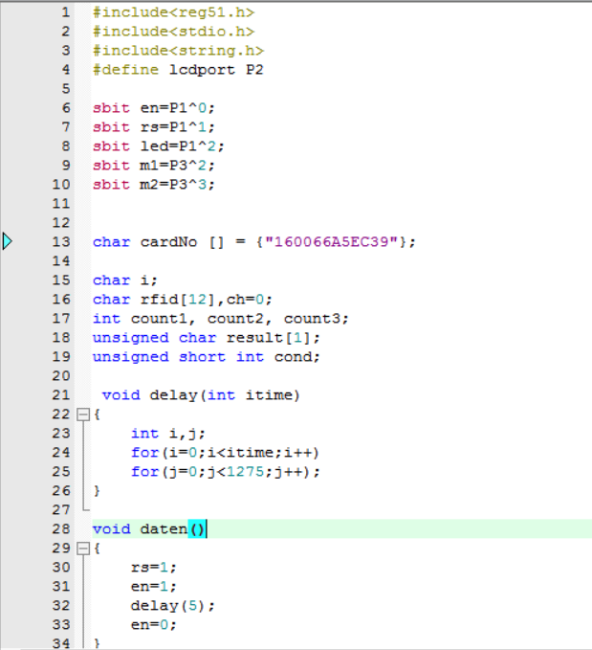
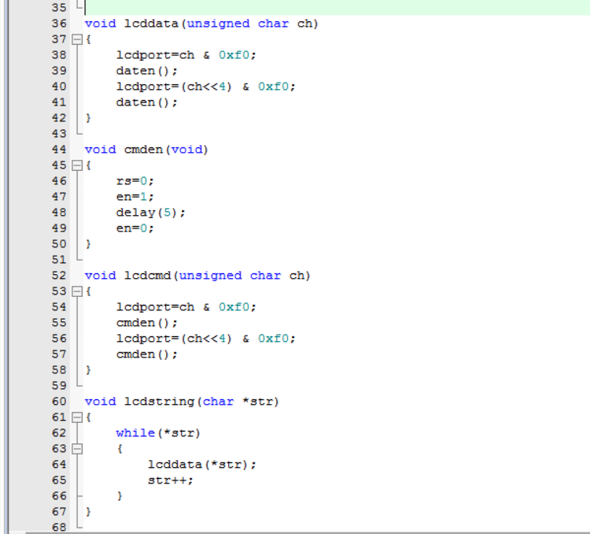
CODE :

Slide 9
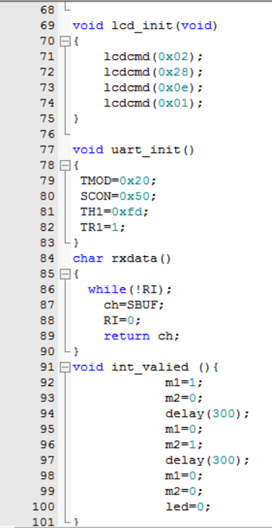
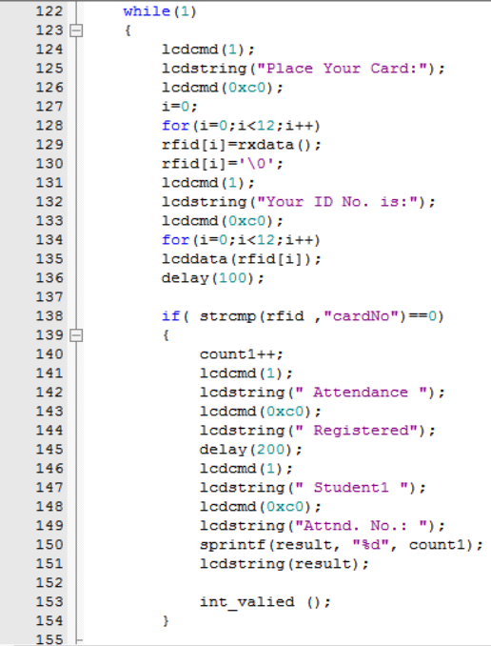
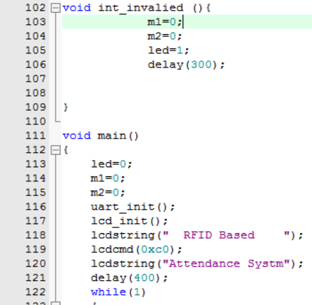
CODE :

Slide 10
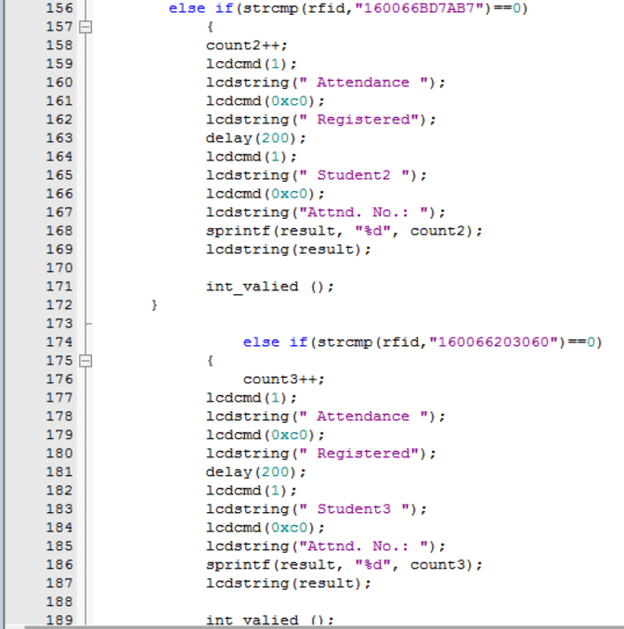
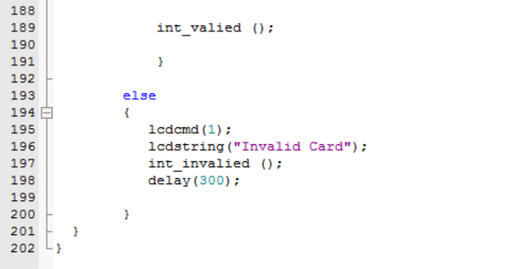
CODE :

Slide 11
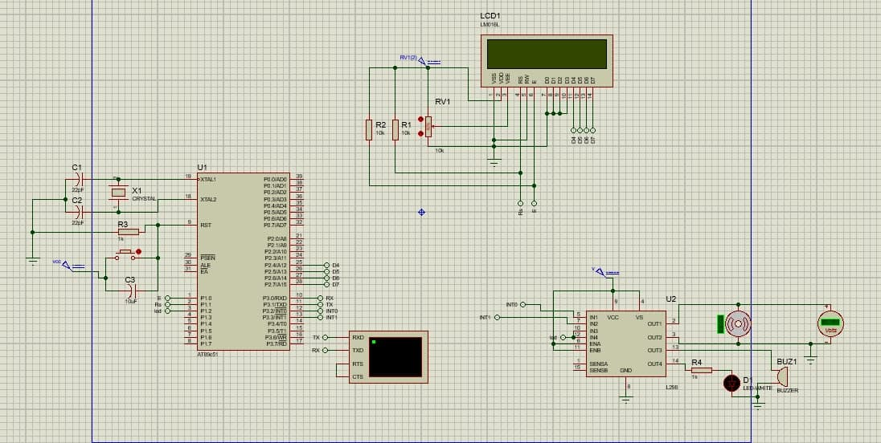
DESIGN ON PROTUES :

Slide 12
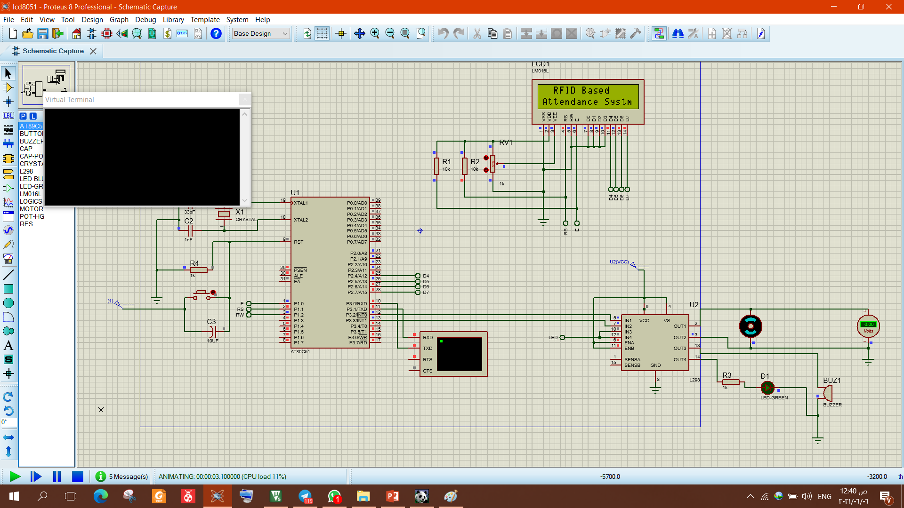
PROTEUS RUN :
1

Slide 13
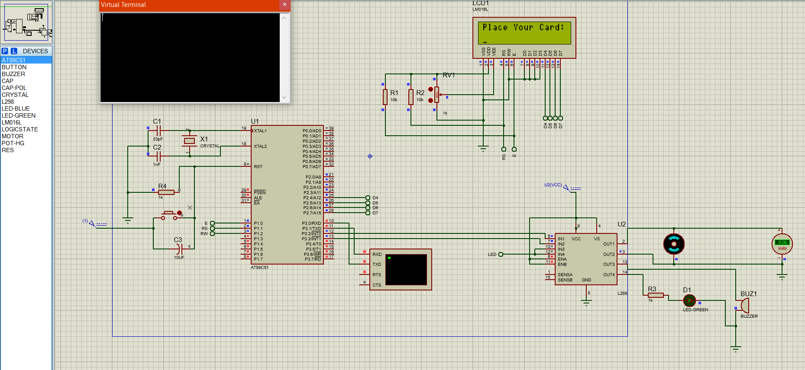
PROTEUS RUN :
2

Slide 14
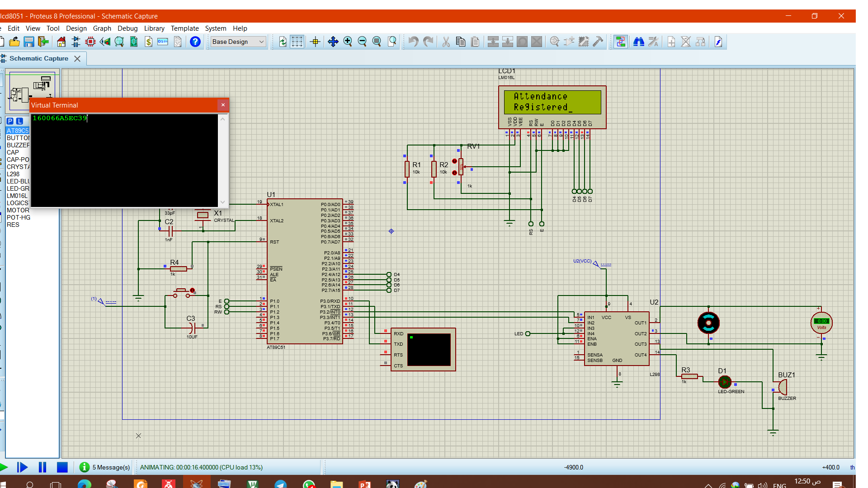
PROTEUS RUN :
3

Slide 15
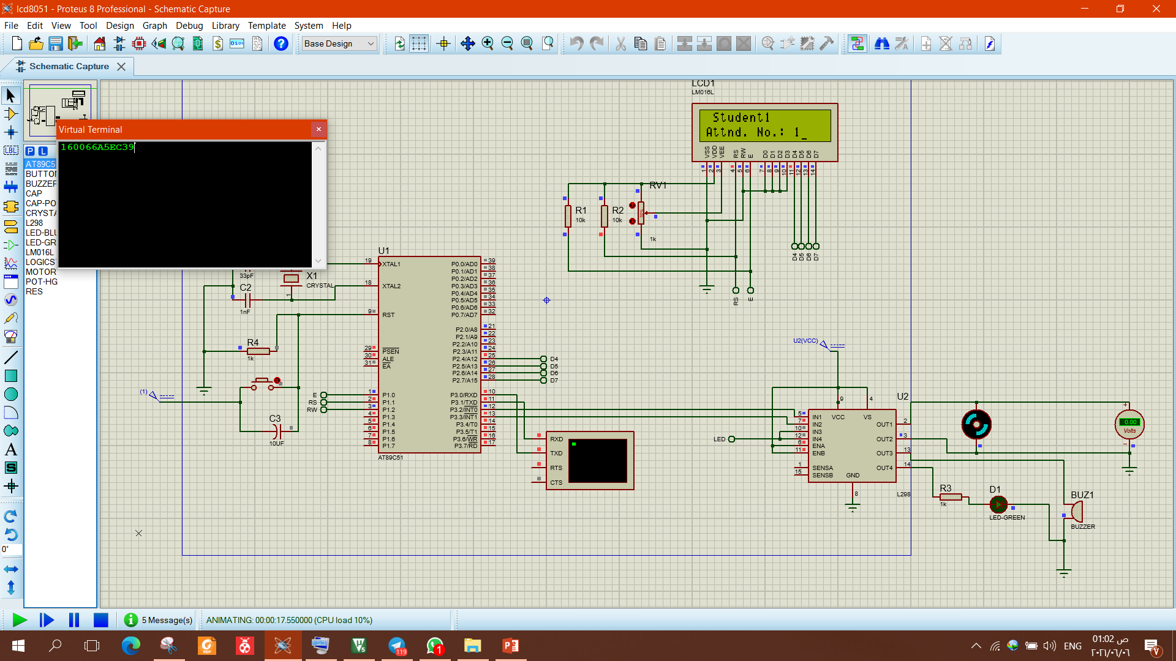
PROTEUS RUN :
4

Slide 16
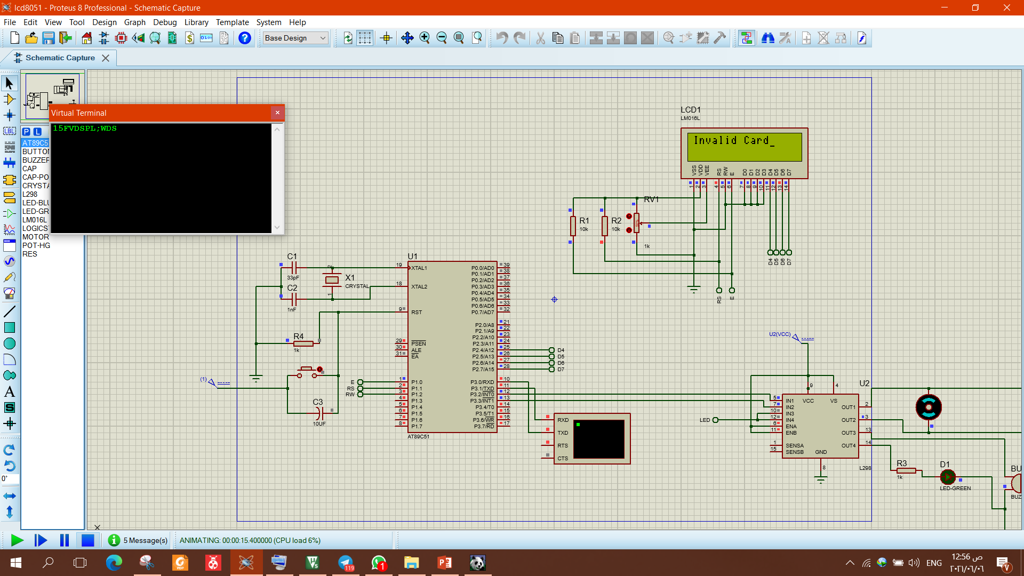
PROTEUS RUN :
Invalid Card

